Slide 1

Mini Voting system
Micro-project In C programing
Department of Basic Science
Submitted By
Mr. Niranjan Dnyaneshwar Joshi
URN: 1024091005
Guided by
Prof. Rutuja Patil
Annasaheb Dange College of Engineering and Technology, Ashta.

Slide 2
Introduction
Purpose: Automate and simplify voting processes.
Voting is a crucial part of democratic systems, ensuring representation and decision-making.
This project presents a simple Electronic Voting System implemented in C programming, designed to automate the voting process for three candidates.
The system is user-friendly, modular, and ensures accurate vote counting and result display

Slide 3
Problem Statement
Traditional voting involves manual counting, leading to:
Errors
Inefficiency
Delays
Objective: Develop a fast, error-free electronic voting solution.

Slide 4
Algorithm
Step 1: Start
Step 2: Initialize: Declare arrays to store candidate names and votes.
Step 3: Input Candidates: Prompt the user to enter the names of three candidates.
Step 4: Display Candidates: Show the list of candidates with numbered options.
Step 5: Accept Votes: Allow users to vote by selecting a candidate or stop voting by entering 0.
Step 6: Validate and Count: Validate the user's choice and update the vote count for the chosen candidate.
Step 7: Display Results: After voting ends, show the total votes received by each candidate.
Step 8: End

Slide 5
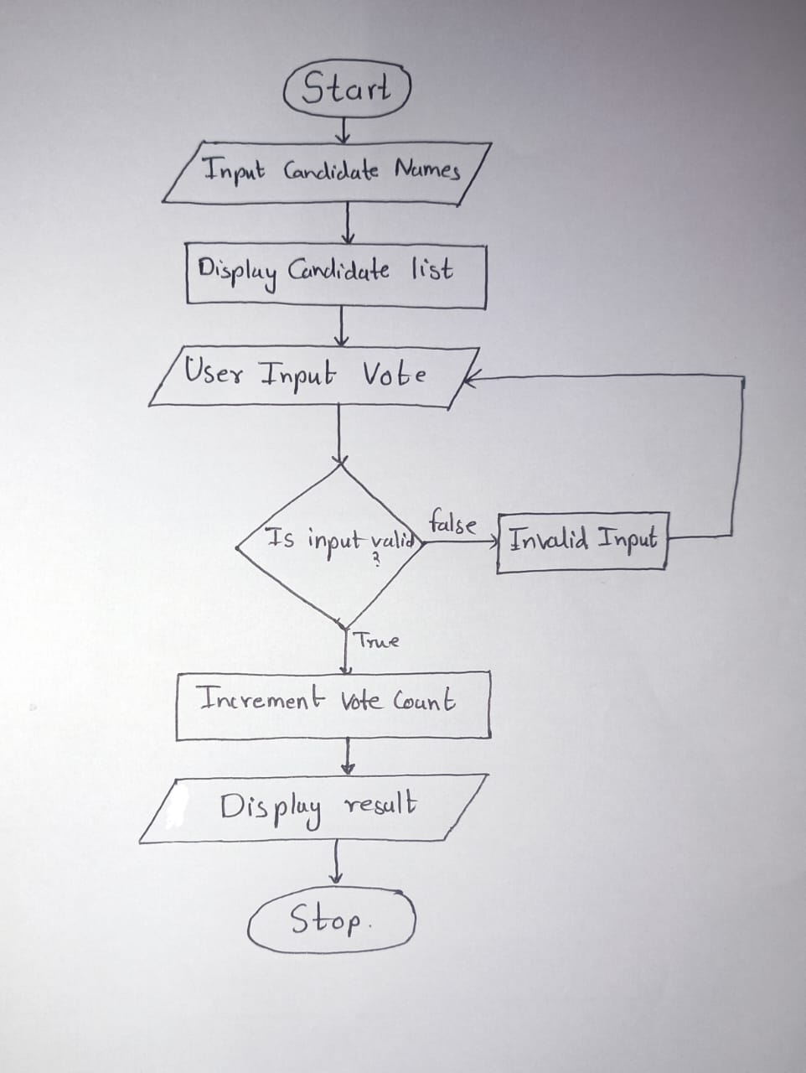
Flowchart

Slide 6
Methodology
File Structure: Modular program (main, header, and implementation files).
Concepts Used:
Arrays for data storage.
Functions for modular operations.
Input validation and error handling.

Slide 7
Results
Example
Input:
Favorite Teacher of The Year
Candidate Names: Rutuja Patil mam, Joshi sir , Shinde sir
Votes: 1, 2, 3, 1, 1,0
Output:
Voting Results:
Rutuja Patil mam: 3 votes
Joshi sir: 1 vote
Shinde sir: 1 vote

Slide 8
Future Scope
Features:
Add more candidates.
Real-time vote tracking with charts.
Platform:
GUI-based systems.
Online voting capabilities.

Slide 9
References
Book: Programming in C by Dennis Ritchie
Online Resources: www.cprogramming.com
Lecture notes.

Slide 10
Thank You

